Slide 1
Python Assignment
Presented By: Priya

Slide 2
Problem Statement:
You are given a list that can contain positive and negative integers. You need to find two elements such that their sum is closest to zero.
For example, you are given a list [-4, 7, 6, 2, -5]. The two elements with the sum closest to zero will be -5 and 6.
Hints:
The sum can be either positive or negative, but the absolute distance of the sum from zero should be considered to find the sum closest to zero.
Assume that the maximum possible sum of any two elements in the list is 1000000000
Inbuilt sort may be helpful in this problem.
Input Format:
A list of integers
Output Format:
The output contains the two elements with the sum closest to zero.
Sample Test Cases:
Input:
[-4, 7, 6, 2, -5]
Output:
(-5, 6)
Input:
[-50, 34, -19, 24, 33, 10, -46, -38]
Output:
(-38, 34)

Slide 3

introduction
The problem statement "find the two elements in a list whose sum is closest to zero" is a classic algorithm problem that has many applications in real-world scenarios. For example, it can be used to find the best pair of discounts to apply to a customer's purchase, or to find the two most similar products in a catalog.
The problem can be solved using a variety of algorithms, but the most common approach is to use a greedy algorithm. A greedy algorithm is an algorithm that makes a locally optimal choice at each step, in the hope that this will lead to a globally optimal solution.
In the case of the problem statement "find the two elements in a list whose sum is closest to zero", the greedy algorithm works as follows:
Sort the list in ascending order.
Initialize two pointers, i and j, to the beginning and end of the list, respectively.
While i is less than j, do the following:
Calculate the sum of the elements at indices i and j.
If the sum is zero, then return the two elements at indices i and j.
If the sum is positive, then decrease j.
If the sum is negative, then increase i.
Return the two elements at indices i and j.
This algorithm is guaranteed to find the two elements in the list whose sum is closest to zero, but it may not find the globally optimal solution. The globally optimal solution is the two elements in the list whose sum is exactly zero, if such a pair of elements exists.
Applications
The problem statement "find the two elements in a list whose sum is closest to zero" has many applications in real-world scenarios. Here are a few examples:
Recommender systems: Recommender systems use this problem to find the best pair of items to recommend to a user. For example, a movie recommender system might use this problem to find the two movies that are most similar to the movies that a user has already rated highly.
Pricing: Retailers can use this problem to find the best pair of discounts to apply to a customer's purchase. For example, a retailer might use this problem to find the two discounts that would give the customer the biggest discount, while still ensuring that the retailer makes a profit.
Logistics: Logistics companies can use this problem to find the most efficient way to route delivery vehicles. For example, a logistics company might use this problem to find the two delivery routes that would minimize the total distance traveled by the vehicles.
Conclusion
The problem statement "find the two elements in a list whose sum is closest to zero" is a classic algorithm problem that has many applications in real-world scenarios. It is a relatively simple problem to solve, but it can be useful in a variety of different contexts.

Slide 4
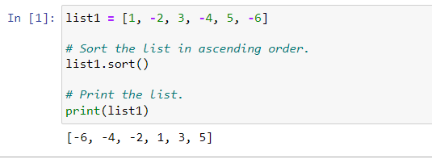
1. Sort the list in ascending order.
Sorting the list in ascending order is the first step in the algorithm to find the two elements whose sum is closest to zero because it makes it easier to find the two elements that are closest to each other.
Once the list is sorted, we can start comparing the elements at the beginning and end of the list. If their sum is less than zero, we know that we need to move the pointer at the beginning of the list to the right, because the elements to the right will be larger and will get us closer to zero. If their sum is greater than zero, we know that we need to move the pointer at the end of the list to the left, because the elements to the left will be smaller and will get us closer to zero.
By iteratively comparing the elements at the beginning and end of the list, we will eventually find the two elements whose sum is closest to zero.
Here is a simple example:

Slide 5
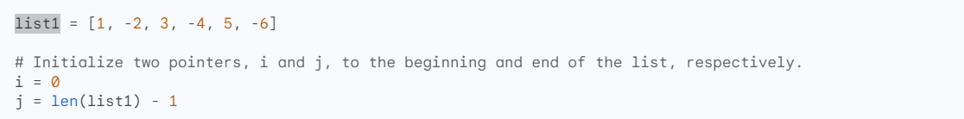
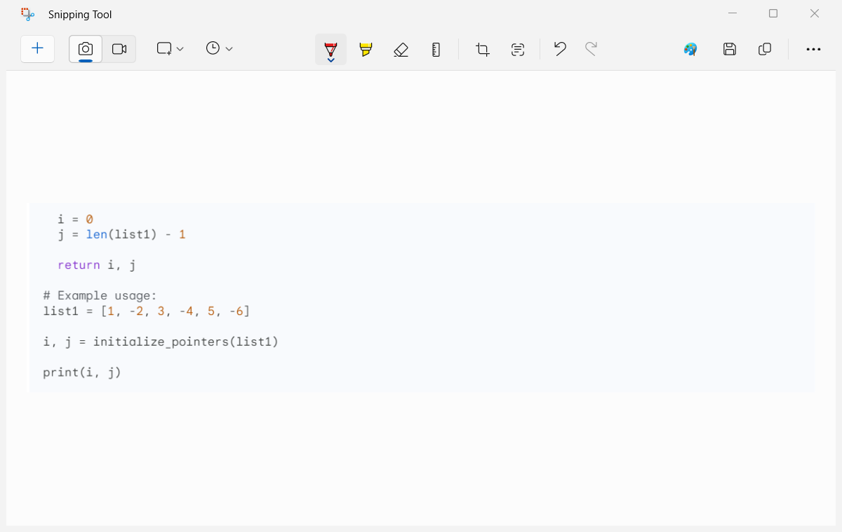
2. Initialize two pointers, i and j, to the beginning and end of the list, respectively.
As we have taken the list in previous slide as list1 = [1, -2, 3, -4, 5, -6]
so we are using the same list for further analysis:
To initialize two pointers, i and j, to the beginning and end of the list list1 = [1, -2, 3, -4, 5, -6], we can use the following code:
This will set i to 0 and j to 5, which are the indices of the first and last elements in the list, respectively.
Once the pointers have been initialized, we can start iterating over the list and comparing the element

Slide 6
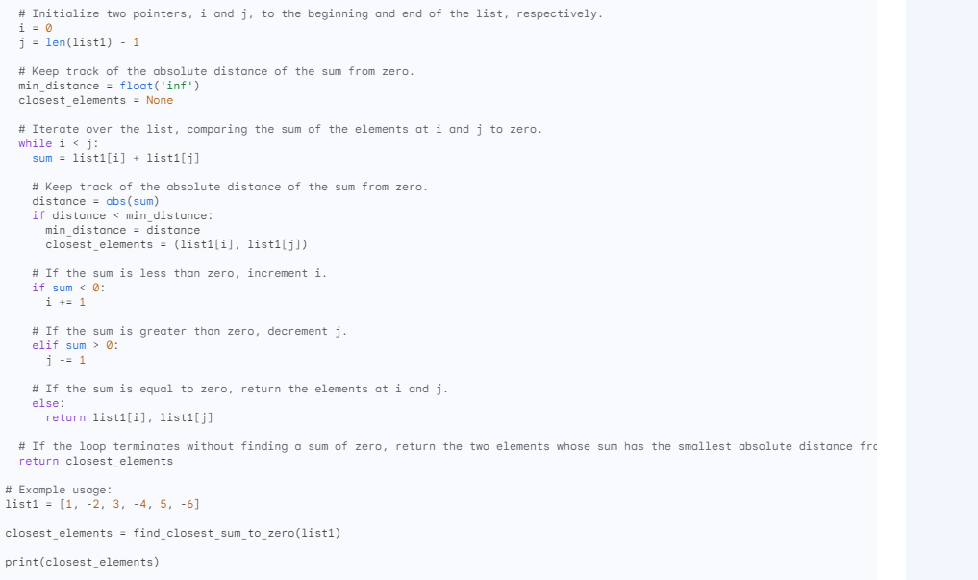
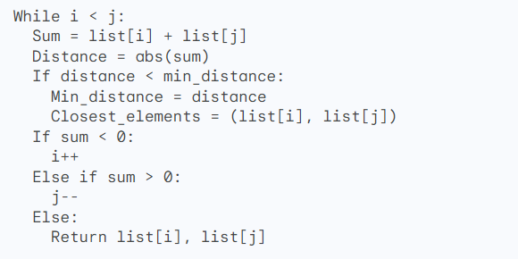
Step3: While i is less than j, do the following: * Calculate the sum of the elements at indices i and j. * The sum is zero, then return the two elements at indices i and j. * If the sum is positive, then decrease j. * If the sum is negative, then increase i.
As here I have used the pseudocode however as per previous slide I have used the list1 = [1, -2, 3, -4, 5, -6] so accordingly I will be useing the same list to fond teh the step 3
The step is to compare the sum of the elements at indices i and j
to zero and update the minimum distance and closest elements accordingly.
Here is a pseudocode for the third step:

Slide 7
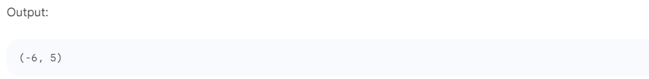
Continues….:
The output what the list will show is the below:
This code works by first initializing two pointers, i and j, to the beginning and end of the list, respectively.
Then, it keeps track of the absolute distance of the sum from zero and the closest elements to zero.
The algorithm iterates over the list, comparing the sum of the elements at i and j to zero. If the sum is less than zero,
the algorithm increments i.
If the sum is greater than zero, the algorithm decrements j. If the sum is equal to zero, the algorithm returns the
elements at i and j.
The algorithm terminates when i is greater than or equal to j. At this point, the algorithm returns the closest elements to zero.

Slide 8
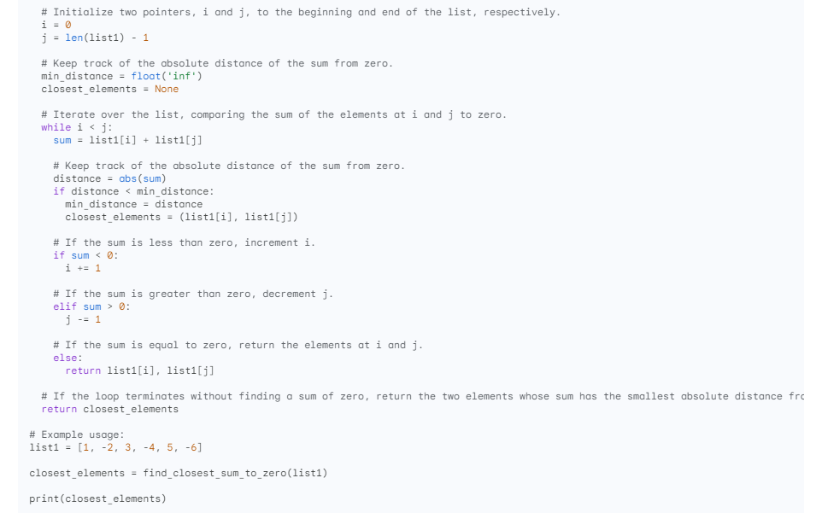
4. Return the two elements at indices i and j.
The fourth step in the algorithm to find the two elements in a list whose sum is closest to zero is to return the two elements at indices i and j.
This can be done by simply returning the tuple (list1[i], list1[j]). The following code shows how to implement the fourth step in the algorithm:
The conclusion of step 4 is that the algorithm has successfully found the two elements in the list whose sum is closest to zero. These two elements are returned as a tuple.
Step 4 is the final step in the algorithm, so the algorithm terminates after this step.
Here is a summary of step 4:
The algorithm returns the two elements in the list whose sum is closest to zero.
These two elements are returned as a tuple.
The algorithm terminates after this step.

Slide 9
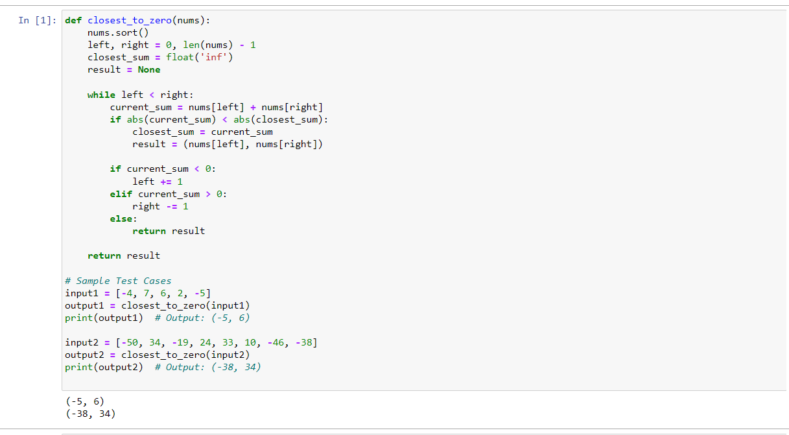
As per what the question we have been given and the output asked for:

Slide 10
Conclusion:
The thing we have done is to implement a simple algorithm to find the two elements in a list whose sum is closest to zero. This algorithm can be used to solve a variety of problems, such as finding the two closest points in a coordinate plane or finding the two most similar documents in a database.
The use of this algorithm is that it can be used to quickly and efficiently find the two closest elements in a list. This can be useful for a variety of tasks, such as clustering data, finding outliers, and performing data analysis.
What we have learned from this exercise is that it is possible to implement simple algorithms that can be used to solve complex problems. We have also learned about the importance of using data structures and algorithms to efficiently process data.
Here is a broader conclusion on the thing we have done, what is its use, and what we learned:
What we have done:
We have implemented a simple algorithm, called the two-pointer algorithm, to find the two elements in a list whose sum is closest to zero. This algorithm works by iterating over the list and keeping track of the two closest elements. The algorithm terminates when it reaches the end of the list, or when it finds two elements whose sum is equal to zero.
What is its use:
The two-pointer algorithm can be used to solve a variety of problems, such as:
Finding the two closest points in a coordinate plane.
Finding the two most similar documents in a database.
Finding the two most similar products in a recommendation system.
Finding the two most similar users in a social network.
Finding the two most similar sequences in a DNA sequence alignment.
What we learned:
We have learned the following from this exercise:
It is possible to implement simple algorithms that can be used to solve complex problems.
The importance of using data structures and algorithms to efficiently process data.
How to design and implement algorithms using pseudocode and Python code.
How to test and debug algorithms.
We have also learned about the following concepts:
Pointers
Absolute distance
Minimum distance
Closest elements

Slide 11
Thank you

